Slide 1
SC1015 Mini
Project: Car Brand
DSF1 Group 4
Ong Jun An (U2121799C)
Tham Zeng Lam (U2121047H)

Slide 2


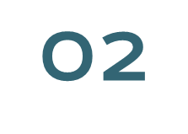

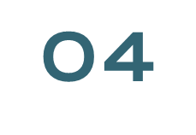
Overview
Practical Motivation
Exploratory Data
Analysis
Machine Learning
Insights

Slide 3

Practical Motivation
According to 2019 Worldwide Cost of Living Survey, Singapore remains the most expensive place in the world to purchase a car (Budget Direct, 2022).
Rising COE prices, due to restricted supply (Tan, 2021)
Variety of car brands in Singapore like Honda, Mercedes, Toyota, Lamborghini, etc,
It was important to determine if customers are spending money on the brand itself or acquiring the specifications features of the car.
It also shows how each brand values their uniqueness in comparison to other brands.

Slide 4
Problem Definition
a)How can we predict the price of a car?
b)How does brand play a part in affecting car prices?

Slide 5
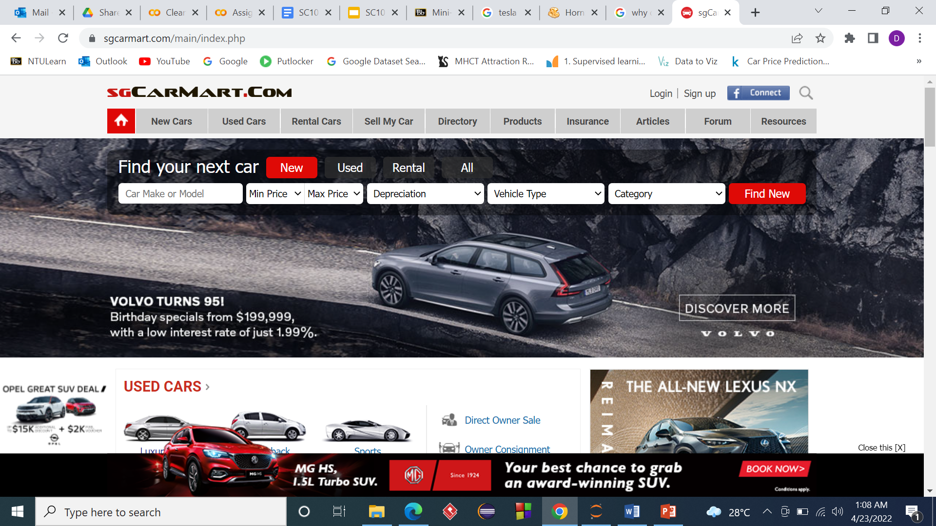
SGCarMart

Slide 6
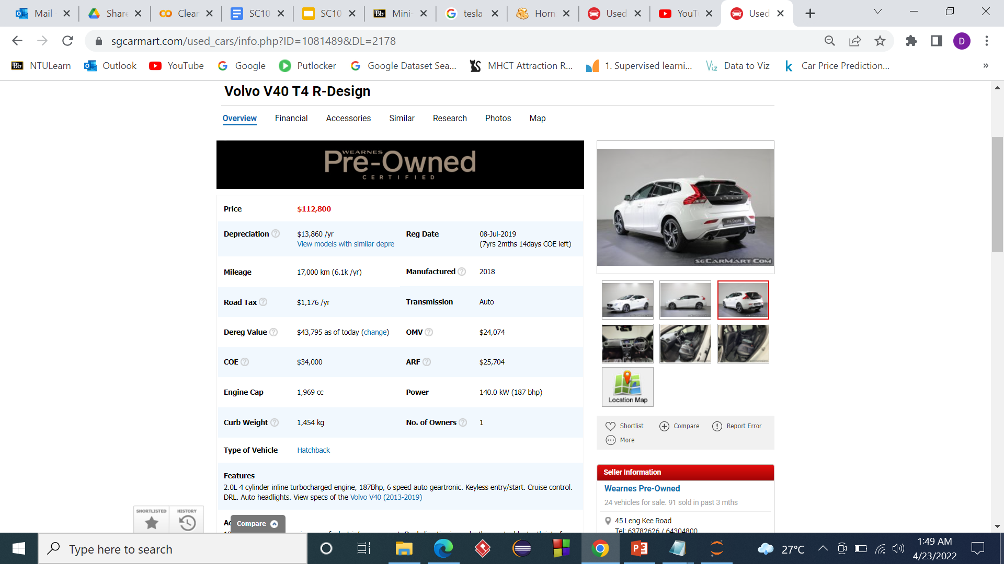
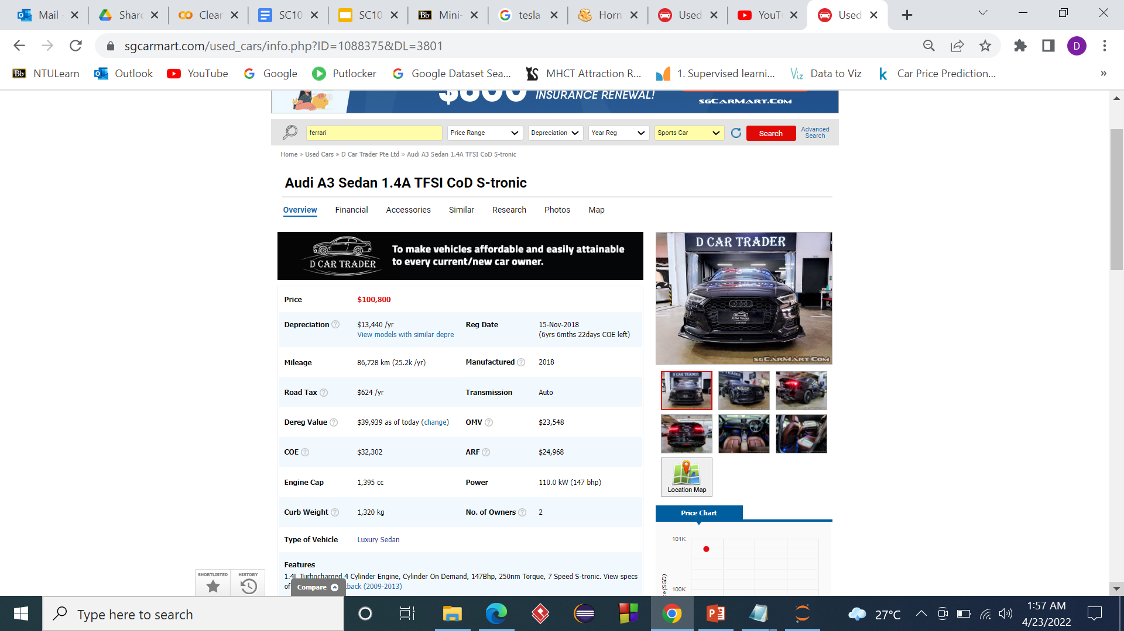
SGCarMart

Slide 7
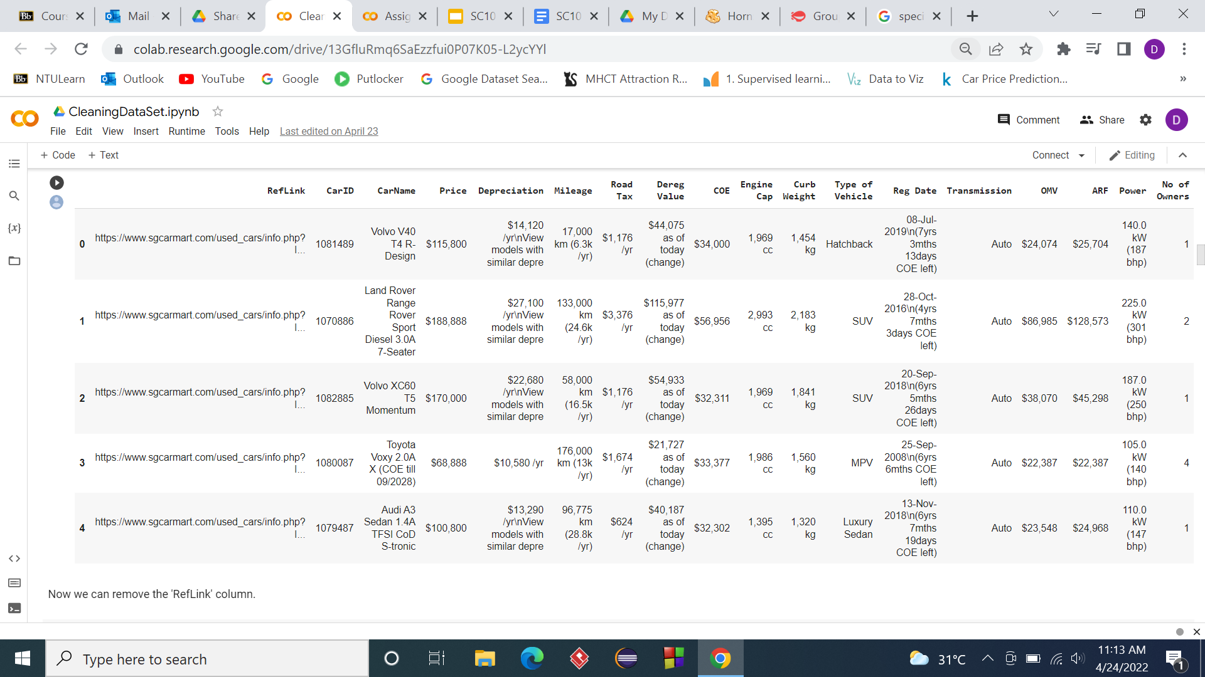
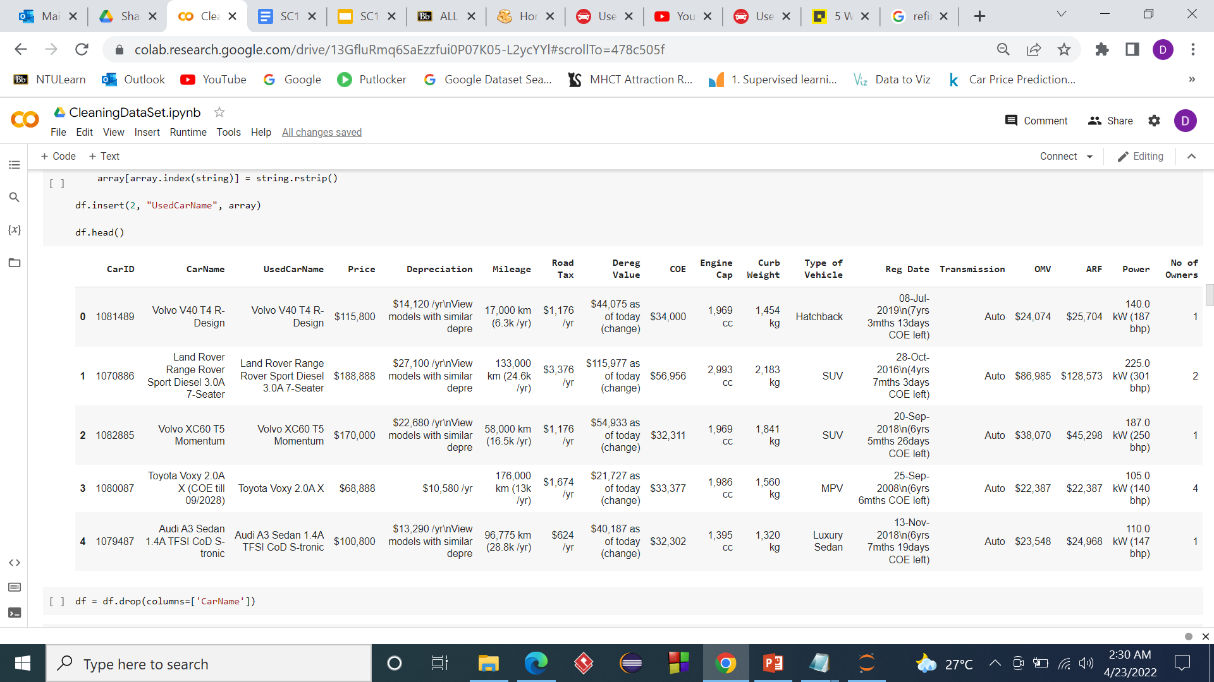
Data Cleaning
1
Modifying RefLink column
2
Trim Car Name

Slide 8
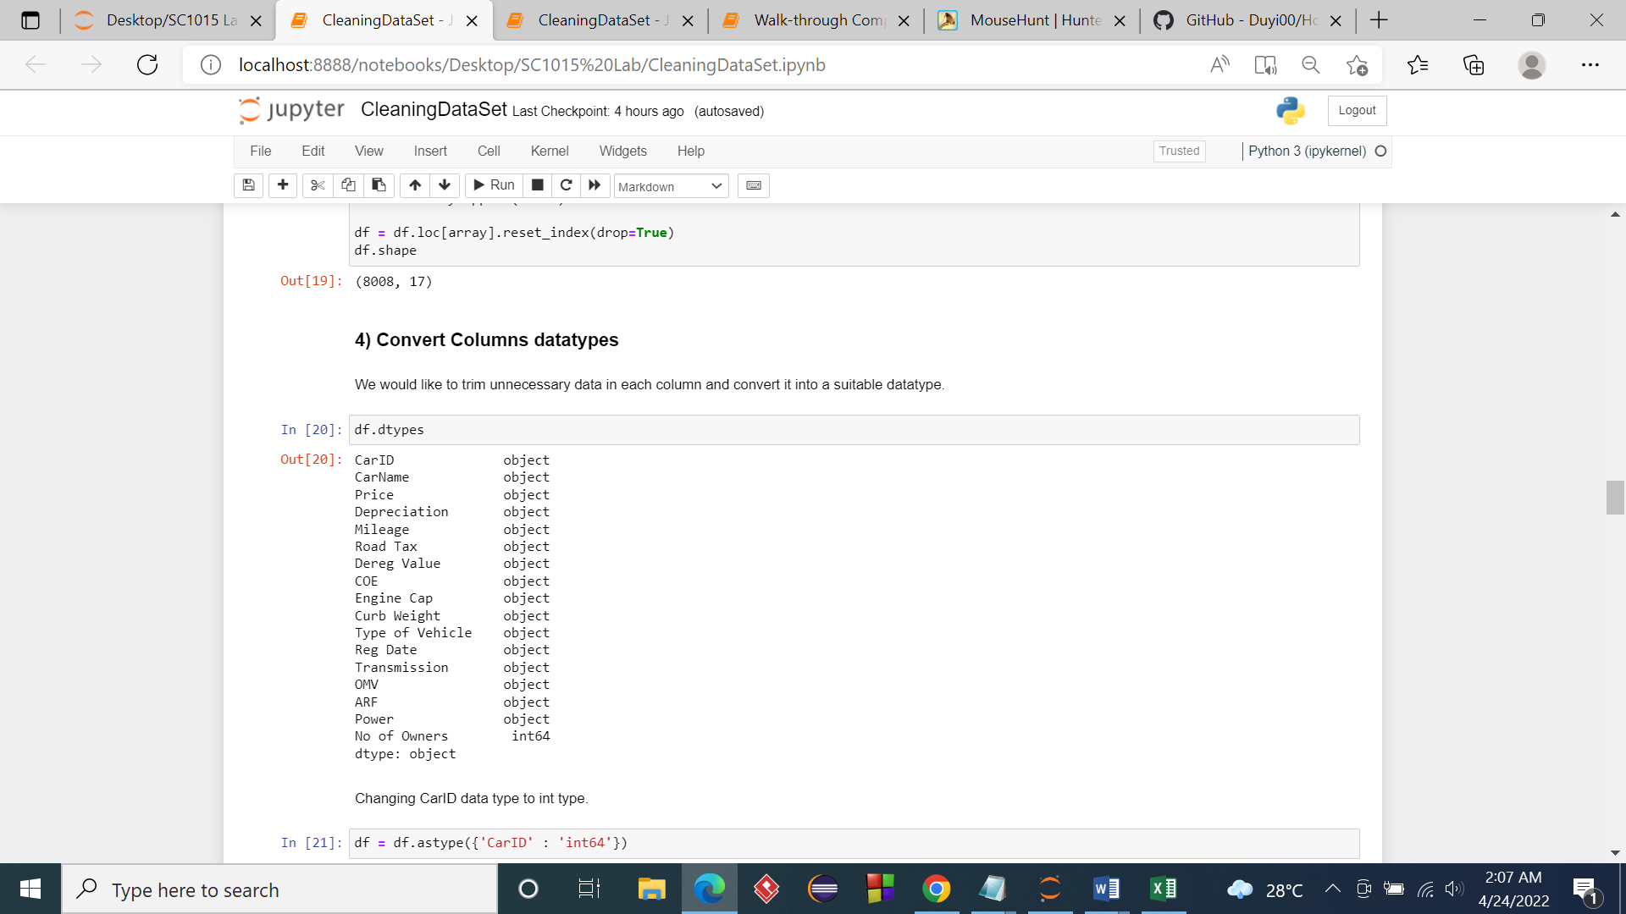
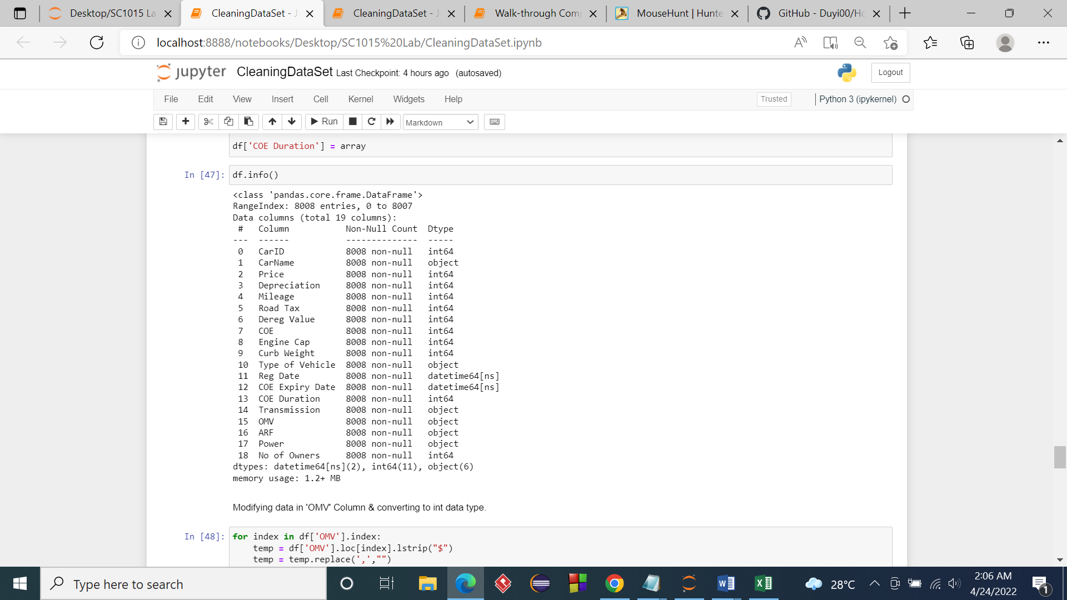
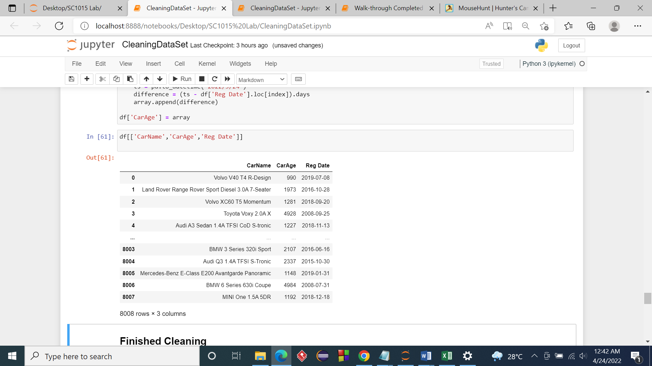
Data Cleaning
3
Convert columns datatype
4
Add CarAge column

Slide 9

Exploratory Data Analysis
6 Most Important factor affecting the price of car (Excluding Car Brand)
Numeric
Categorical
Formulates the price of a typical car based solely on its specifications

Slide 10
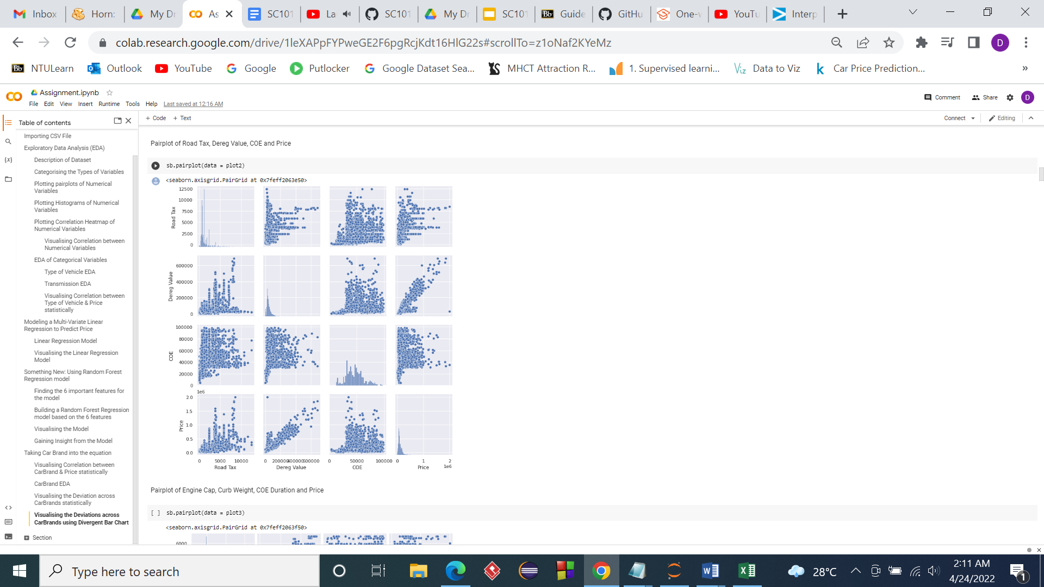
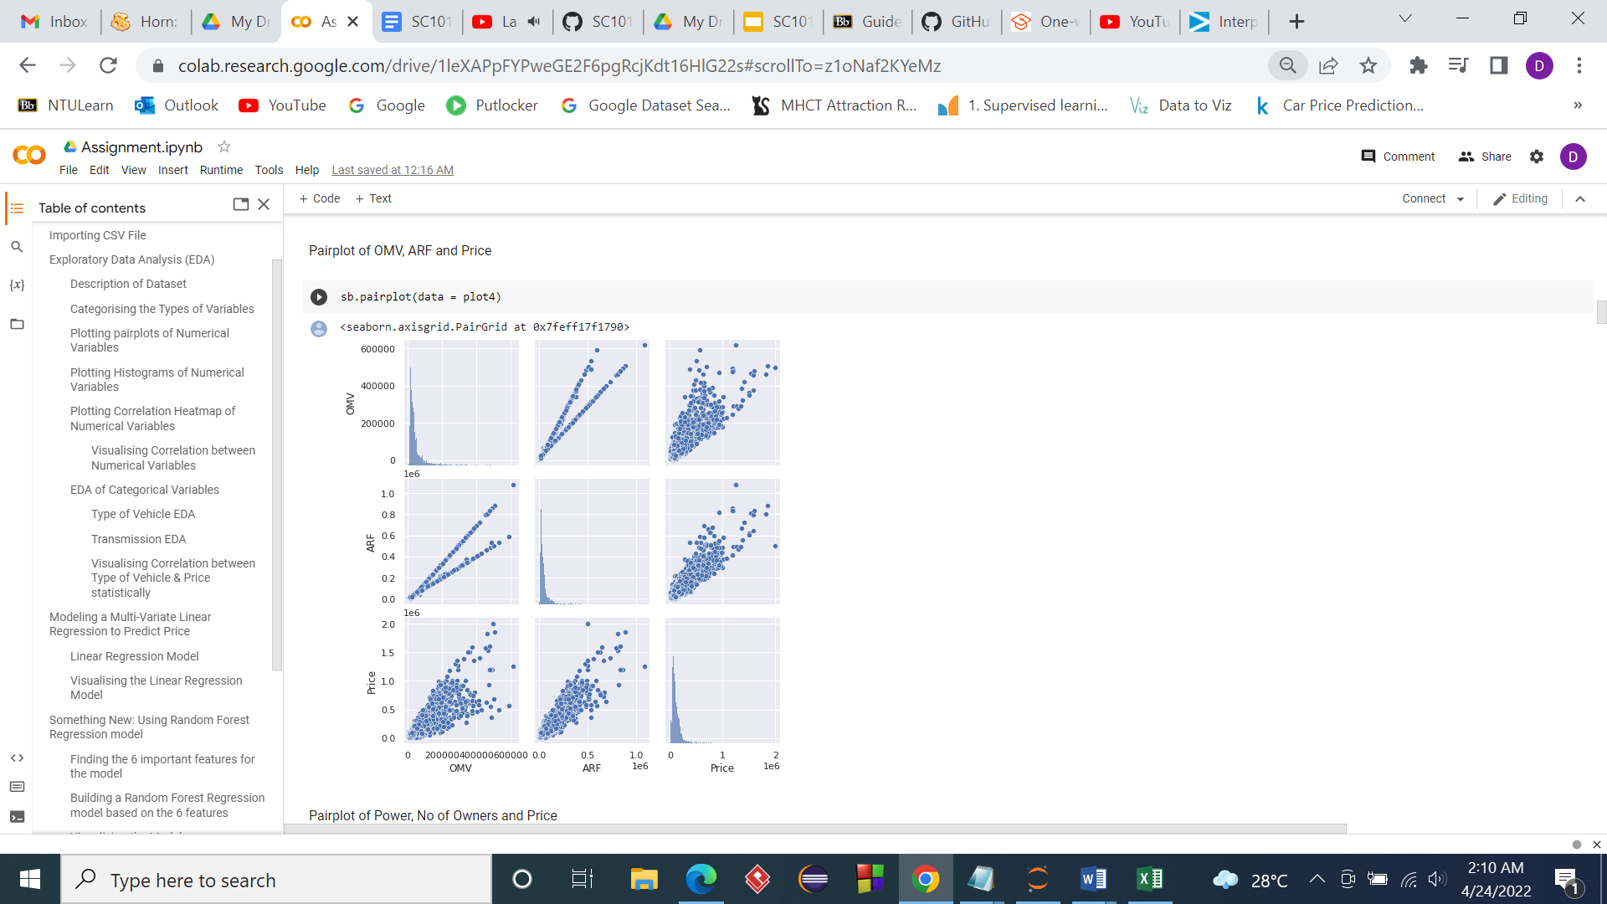
Pairplots

Slide 11
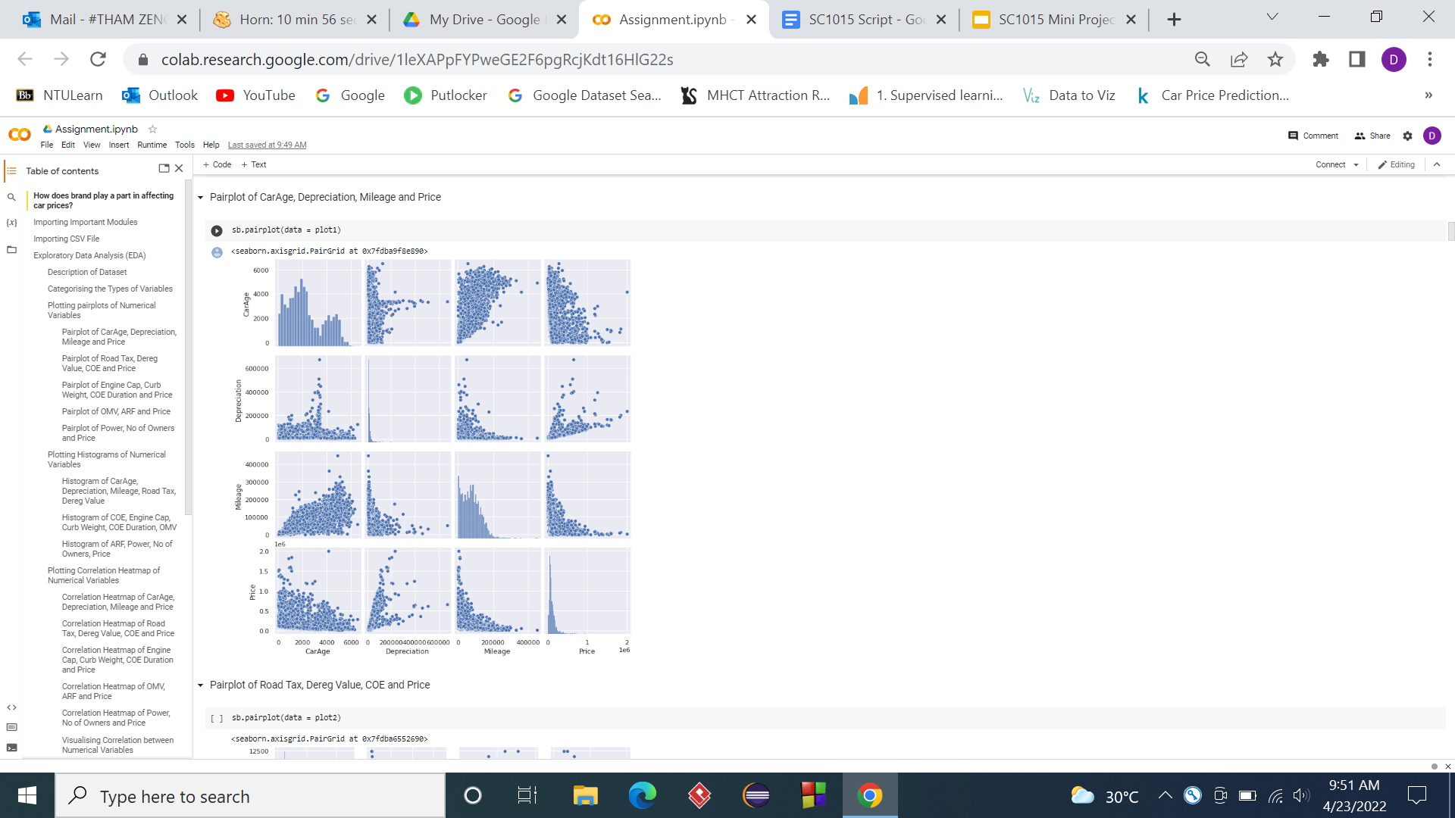
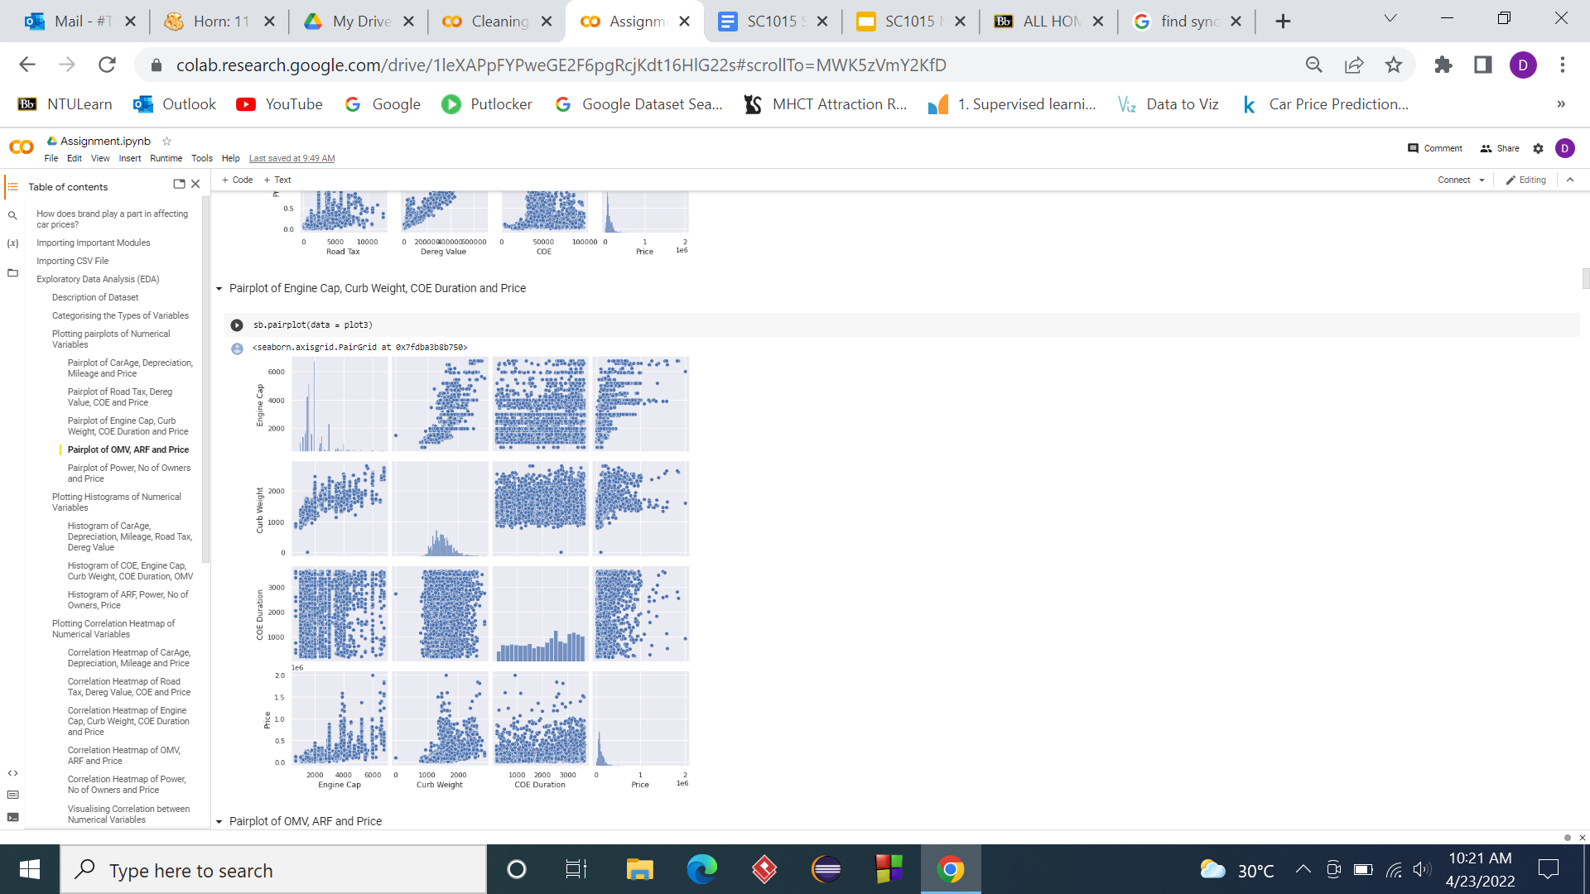
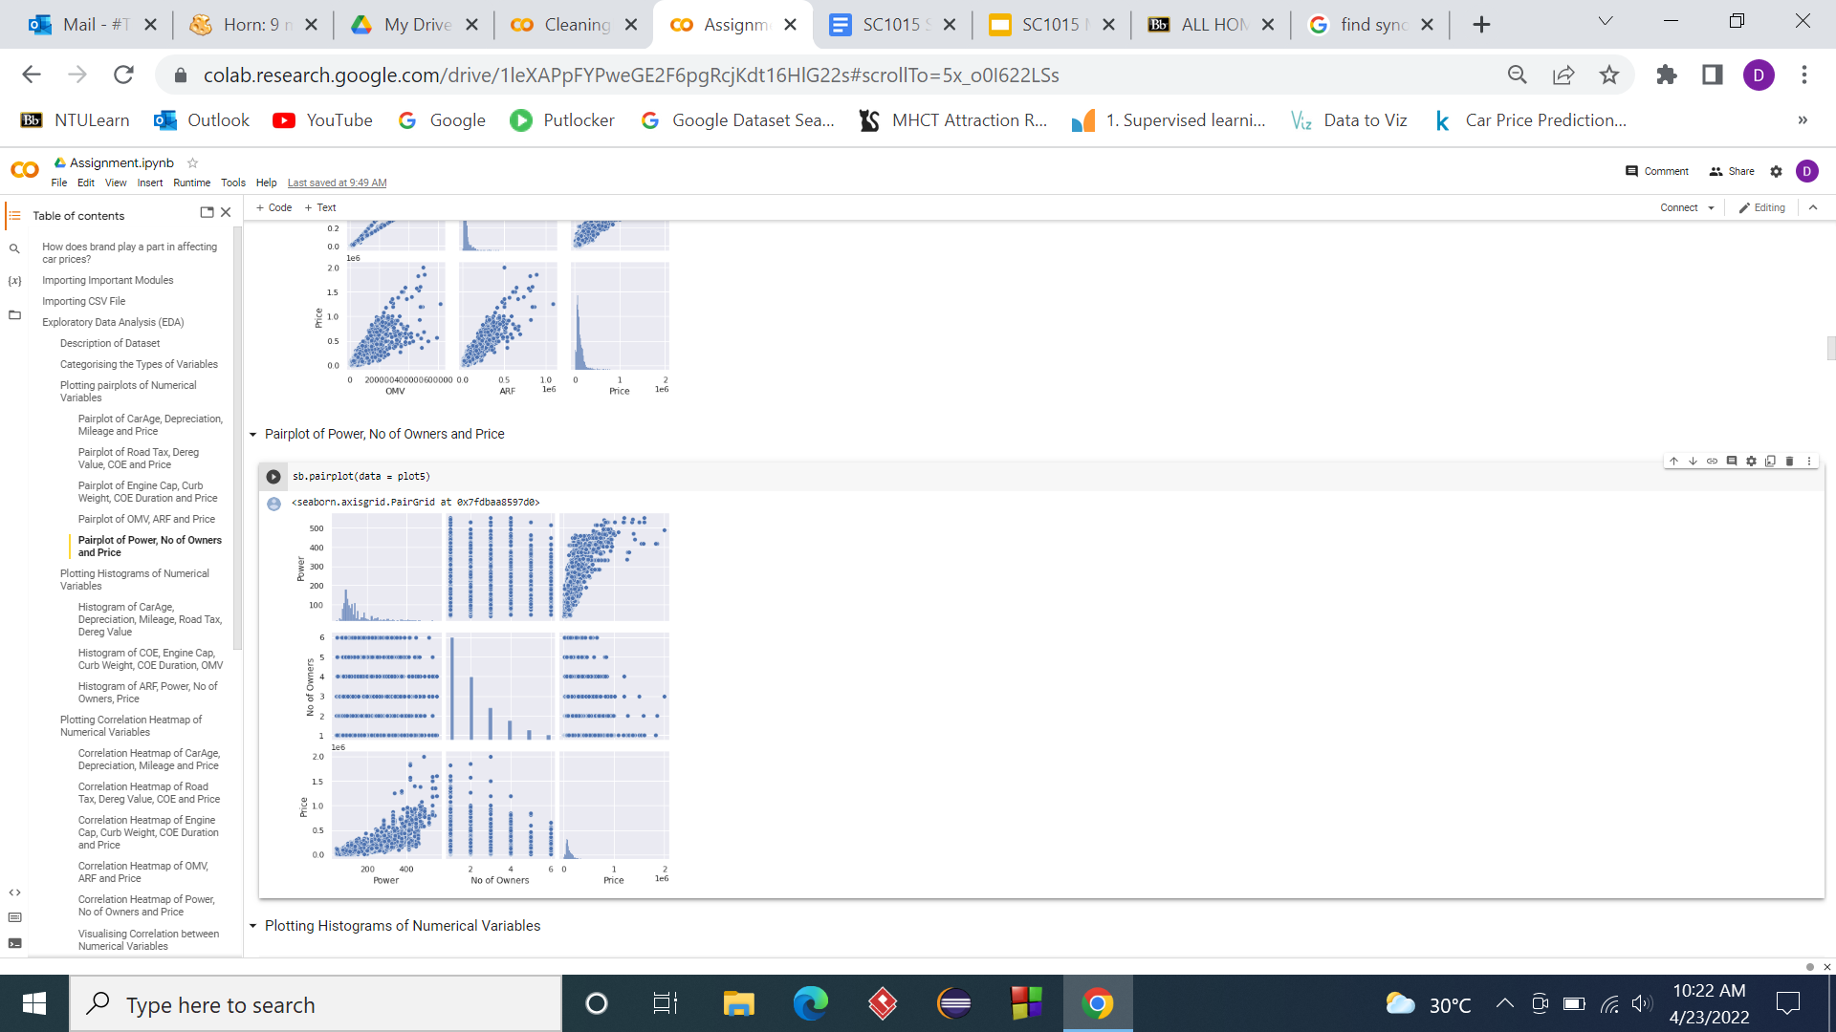
More pairplots

Slide 12
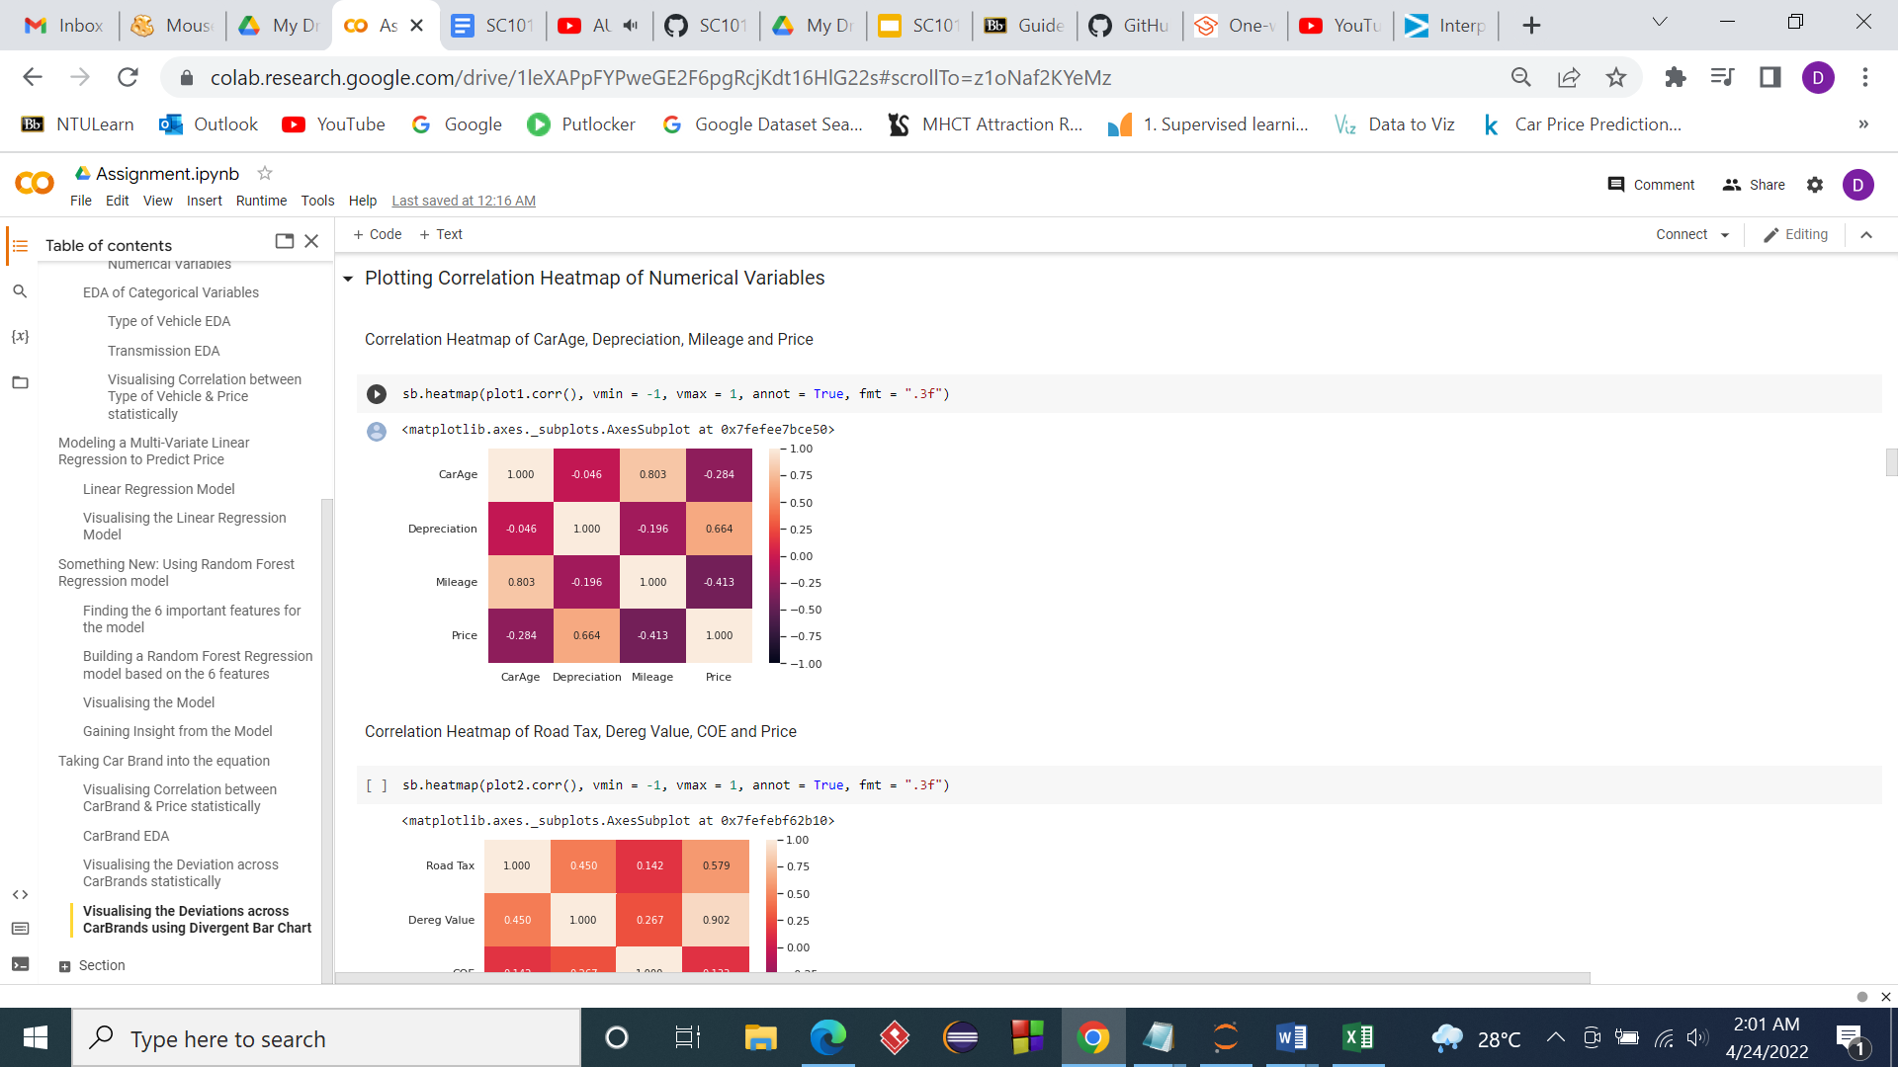
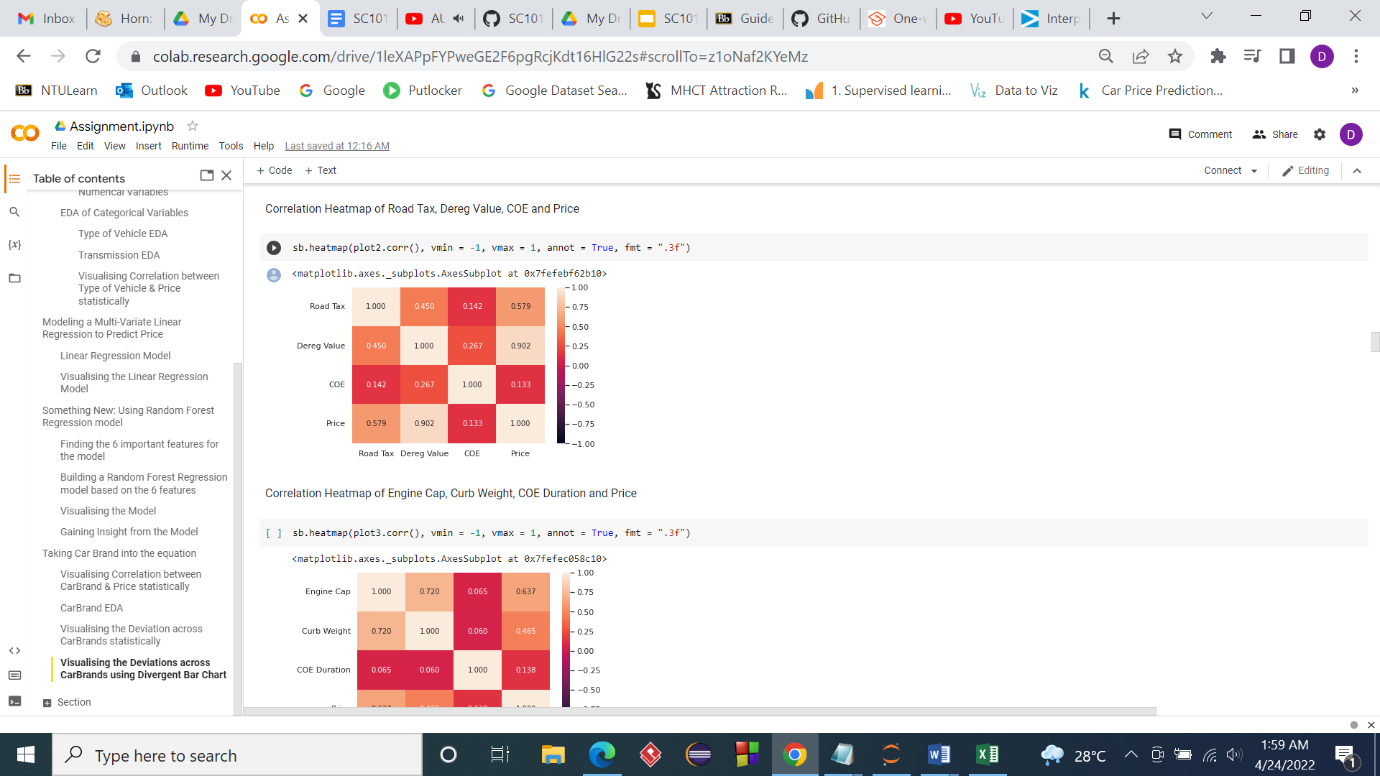
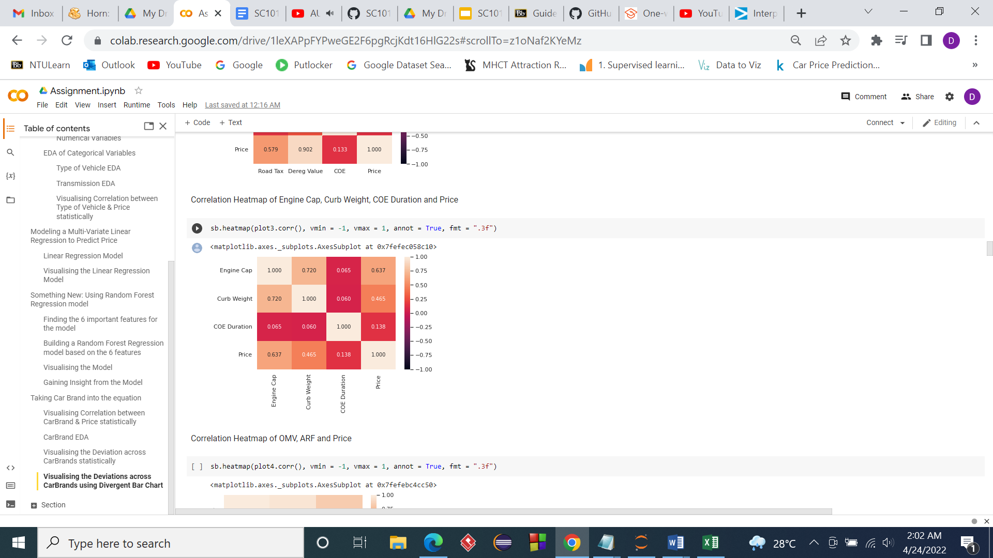
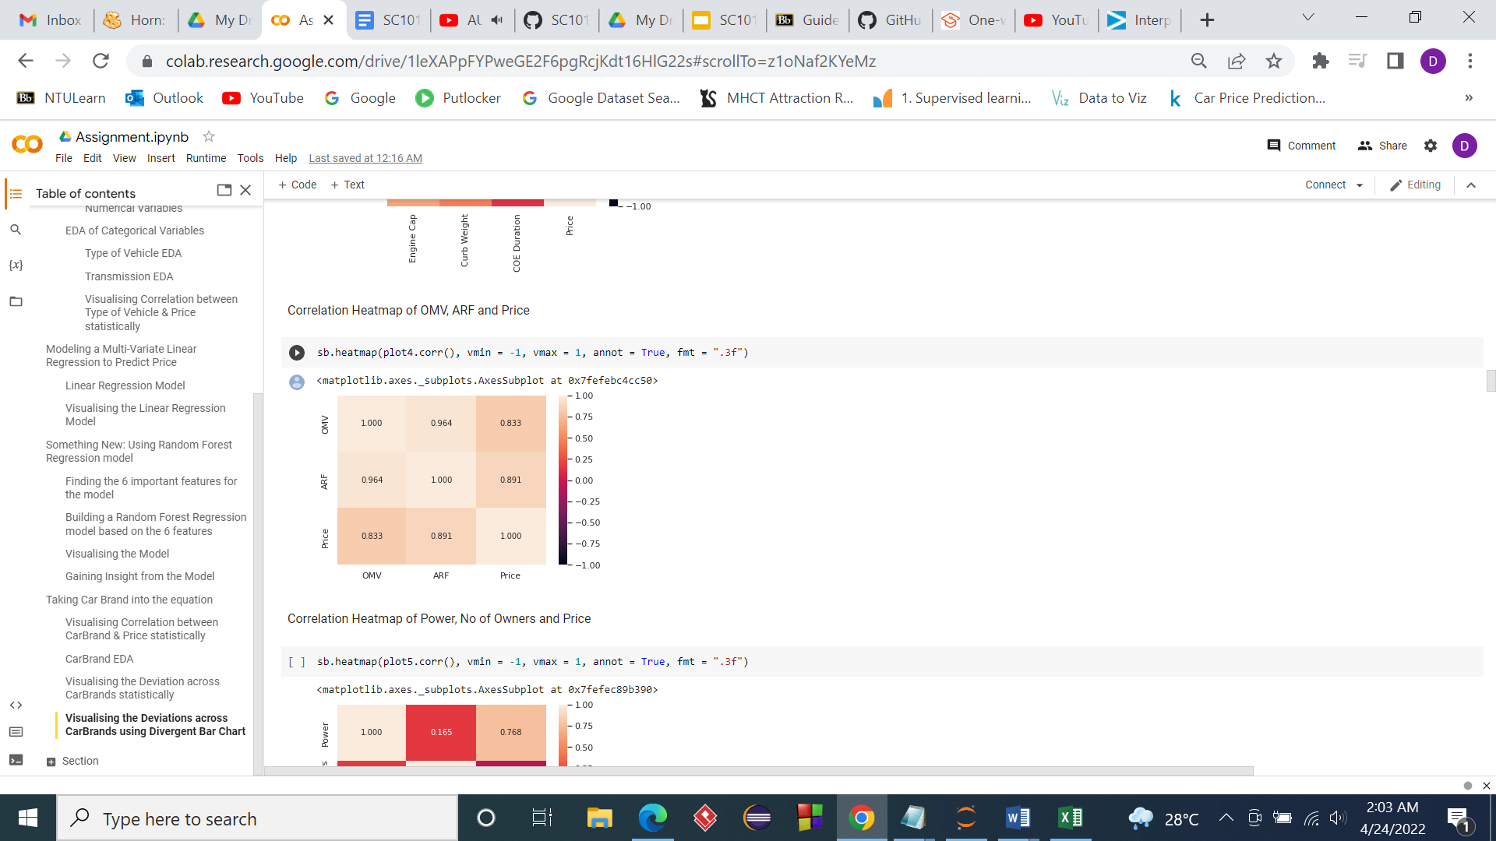
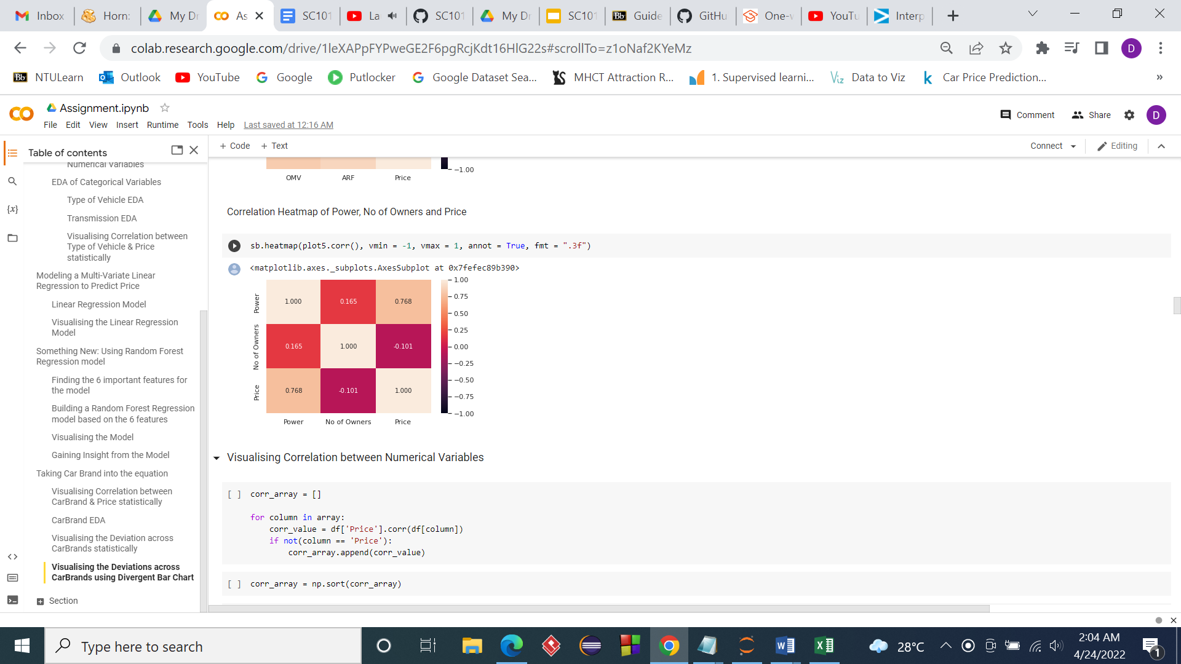
Heatmap (Numeric Variables)

Slide 13
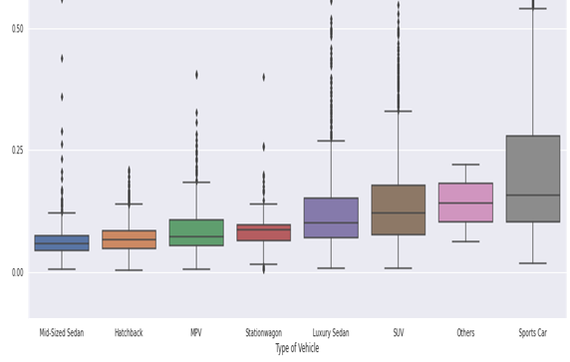
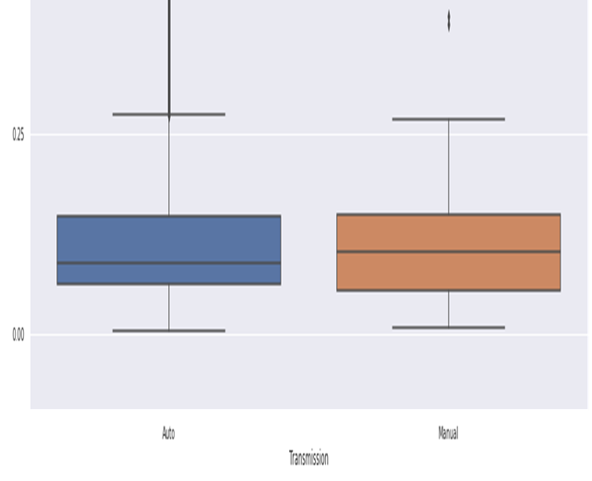
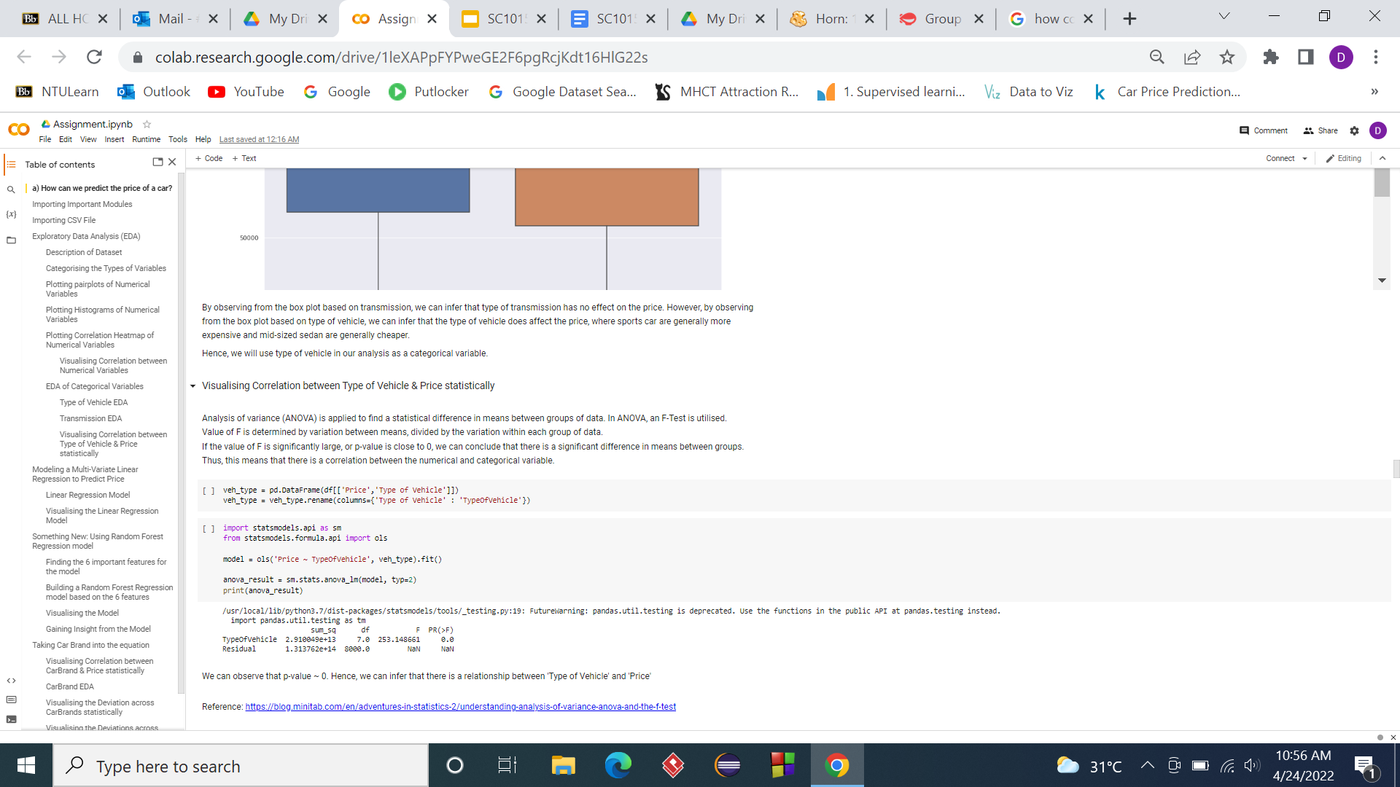
Box Plot (Categorical)
Type of Vehicle
Transmission Mode

Slide 14

EDA Insights
From the heatmap and boxplot, we used the 5 most strongest correlated numeric variables and 1 categorical variable in our analysis.
The 5 numeric variables are Deregistration value, Additional Registration Fee, Open Market Value, Power and Depreciation. The categorical variable is type of vehicle.

Slide 15
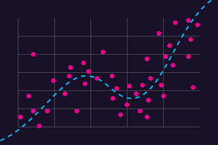
“How to predict a price of a car?”
Regression model :
Price = 𝑓 ( variables )

Slide 16
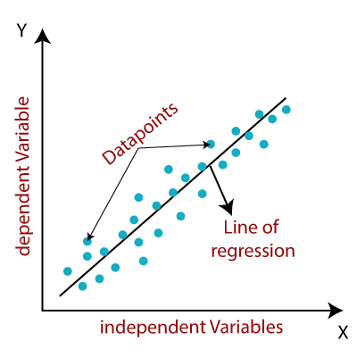
Model 1 : Multi - Variate Linear Regression
a *
b *
c *
d *
e *
Deregistration Value
Additional Registration Fee
Open Market Value
Depreciation
Power
Predicted Price
of a car
f *
f₁ * Hatchback + f₂ * SUV + …
f₇ * Sports Car
error + a Constant
Type of Vehicle
error + a Constant
minimise

Slide 17
K-fold Cross-Validation of Model
Best
Model
Validation
80%
20%
Train Dataset
Test Dataset

Slide 18
Results of Linear Regression Model
 | Train Dataset | Test Dataset
Explained Variance | ~0.907 | ~0.899
Mean Squared Error | ~1.75 x 10⁹ | ~2.25 x 10⁹

Slide 19
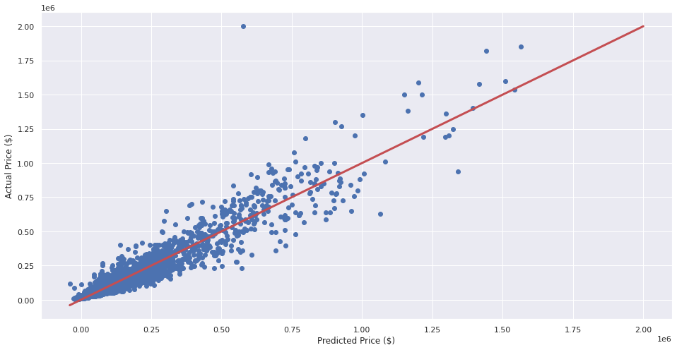
Graph of Linear Regression

Slide 20
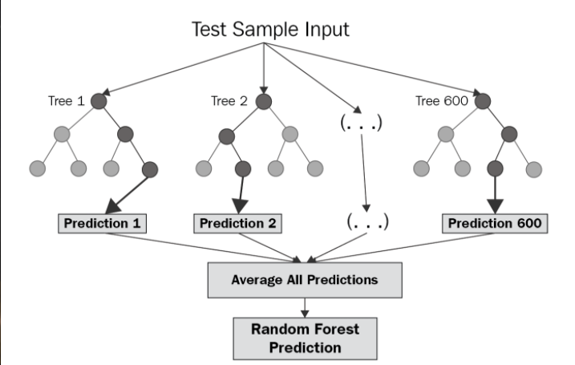
Model 2 : Random Forest Regression
Ensemble Technique

Slide 21
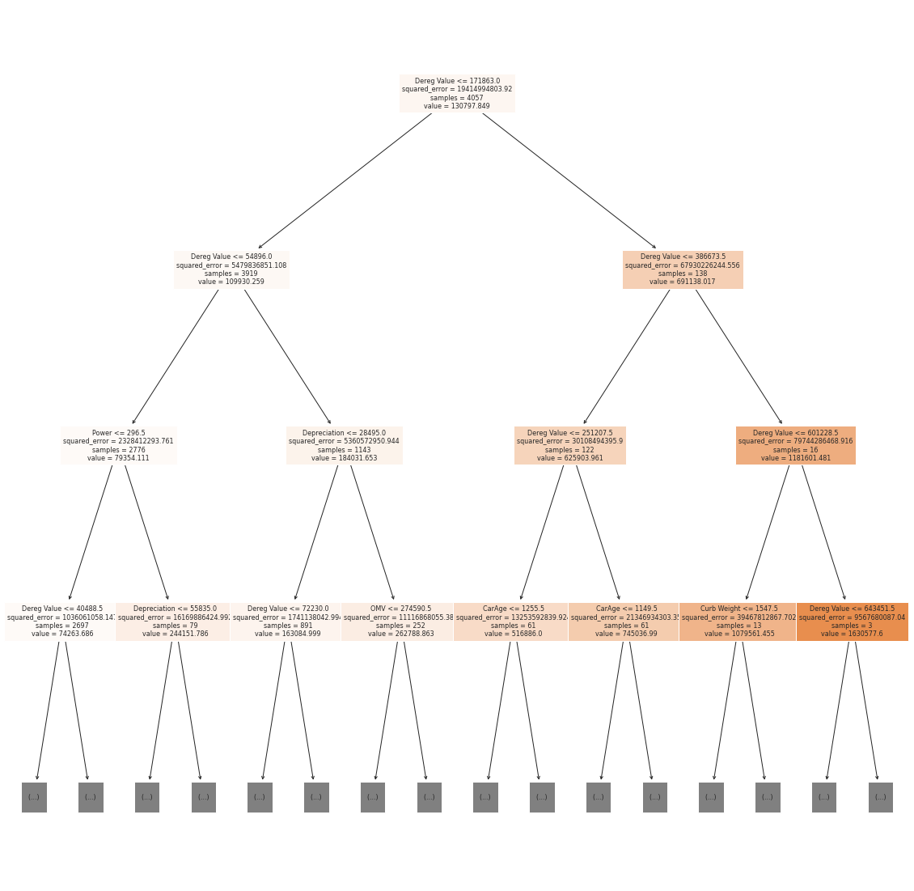
A Decision Tree (Example)

Slide 22
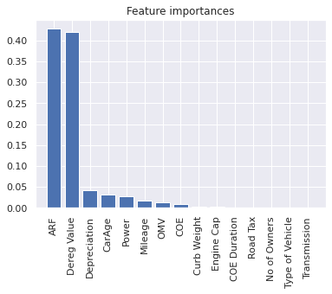
Feature Importance from Random Forest

Slide 23
Results of Random Forest Regression Model
 | Train Dataset | Test Dataset
Explained Variance | ~0.972 | ~0.980
Mean Squared Error | ~5.64 x 10⁸ | ~3.86 x 10⁸

Slide 24
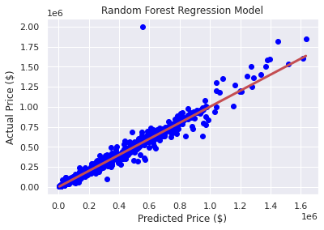
Graph of Random Forest Regression

Slide 25
Insight : How does brand play a part in affecting car prices
Outliers: Furthest away from the Regression Line
Ferrari 599 GTO
Rolls-Royce Cullinan 6.75A
Porsche 911 Speedster 4.0M
Ferrari 488 Pista
Ferrari F8 Tributo
Rolls-Royce Ghost Series II LWB
Rolls-Royce Ghost EWB
Ferrari F430 Scuderia
Porsche 911 Speedster 4.0M

Slide 26
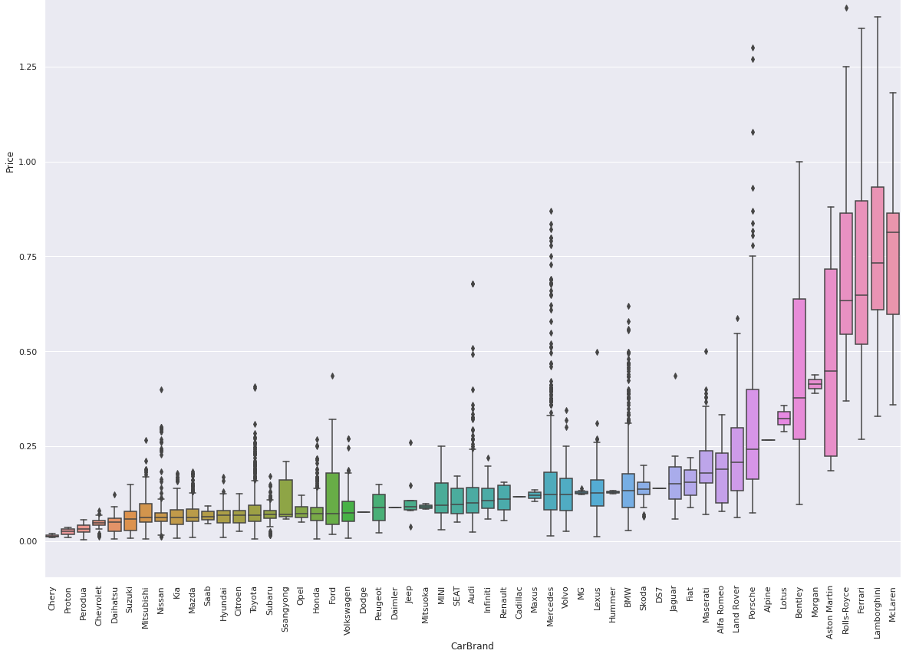
EDA of Car Brand

Slide 27
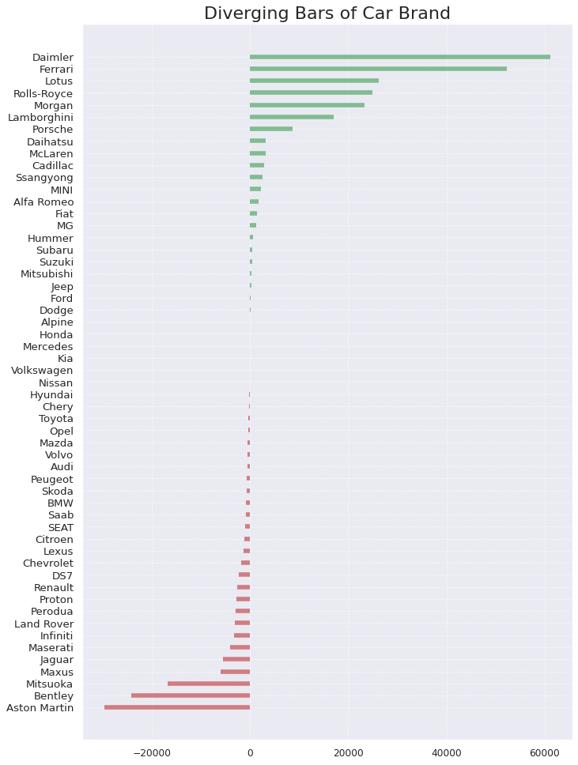
Divergent Bar of Deviation in Price across Car Brands
Daimler
Ferrari
Lotus
Rolls-Royce
Morgan
Lamborghini

Slide 28
Conclusion
We can predict the price of a car by using a regression model with the help of random forest that determines the few most important variables affecting the price.
There are some underlying factors that make some car brands to be priced higher.

Slide 29
Future Application
Car manufacturers can use the model to gauge an appropriate selling price for the car, given their reputation in the Singapore market.
Customers can also utilise this model to determine a well-priced car.

Slide 30
Recommendation
Users can inculcate some qualitative assessments of car brands in Singapore to further improve the project, so as to factor in brand into the model.

Slide 31
THANKS
Please keep this slide for attribution.

Slide 32
References
Budget Direct. (2022, January). Why are cars so expensive in Singapore? - budget direct. Why are cars so expensive in Singapore? Retrieved April 23, 2022, from https://www.budgetdirect.com.sg/car-insurance/research/why-are-cars-so-expensive-in-singapore
Tan, C. (2021, October 20). Coe prices soar ahead of Supply Shrinkage. The Straits Times. Retrieved April 23, 2022, from https://www.straitstimes.com/singapore/coe-prices-soar-ahead-of-supply-shrinkage
Bevans, R. (2020, October 26). An introduction to multiple linear regression. Scribbr. Retrieved April 24, 2022, from https://www.scribbr.com/statistics/multiple-linear-regression/
Introduction to random forest in machine learning. Section. (n.d.). Retrieved April 24, 2022, from https://www.section.io/engineering-education/introduction-to-random-forest-in-machine-learning/
(Picture of Regression Model) : What is a regression model? IMSL by Perforce. (n.d.). Retrieved April 24, 2022, from https://www.imsl.com/blog/what-is-regression-model
(Picture of Linear Regression Model) : Linear regression in machine learning - javatpoint. www.javatpoint.com. (n.d.). Retrieved April 24, 2022, from https://www.javatpoint.com/linear-regression-in-machine-learning
(Picture of Random Forest Regression) : Bakshi, C. (2022, April 14). Random Forest regression. Medium. Retrieved April 24, 2022, from https://levelup.gitconnected.com/random-forest-regression-209c0f354c84
Image Reference

